Slide 1
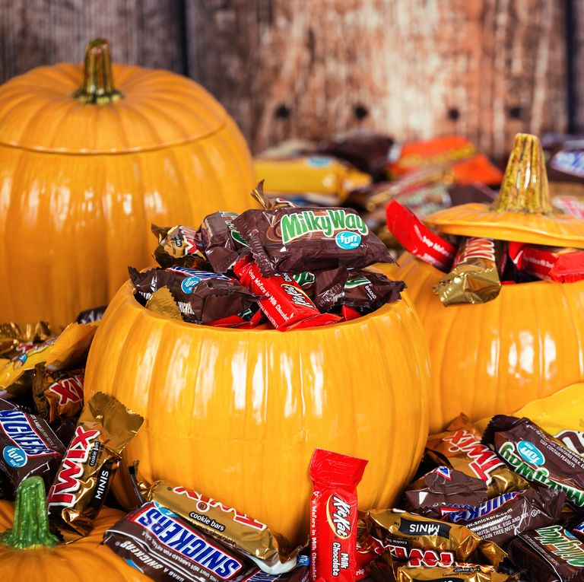

CANDY DATA
CANDY DATA
By Priyanki Das

Slide 2
DATA DESCRIPTION
This is a hallowen candy voting data. Each row in the dataset corresponds to one type of Halloween candy. Participants are shown different candies two at time and were asked which candy do they prefer. After aggregating all the votes, each candy is given winpercent. Explanatory Variables are described as below.
chocolate: Does it contain chocolate?
fruity: Is it fruit flavored?
caramel: Is there caramel in the candy?
peanutalmondy: Does it contain peanuts, peanut butter or almonds?
nougat: Does it contain nougat?
crispedricewafer: Does it contain crisped rice, wafers, or a cookie component?
hard: Is it a hard candy?
bar: Is it a candy bar?
pluribus: Is it one of many candies in a bag or box?
sugarpercent: The percentile of sugar it falls under within the data set.pricepercent:
The unit price percentile compared to the rest of the set. winpercent: The overall win percentage according to 269,000 matchups. Winpercent is the target variable.

Slide 3
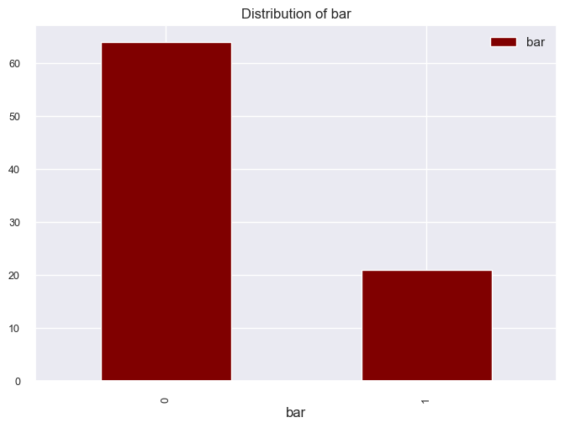
From this graph we can see that the count of bar candies is 0-20.

Slide 4
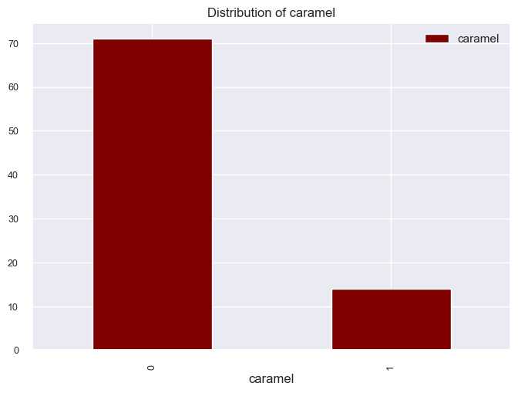
Here we can see that the count of caramel candies is 10-15.
Here we observe that the distribution of caramel candy is 10-15.

Slide 5
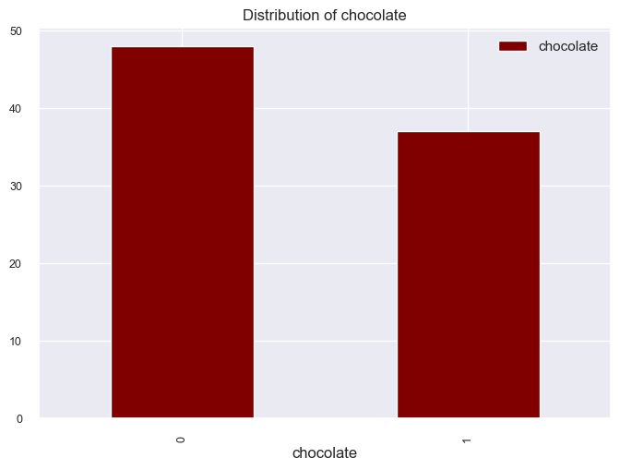
Here the distribution of chocolate candies is 30-35.
The graph shows us that the distribution of chocolate candy is 30-38.

Slide 6
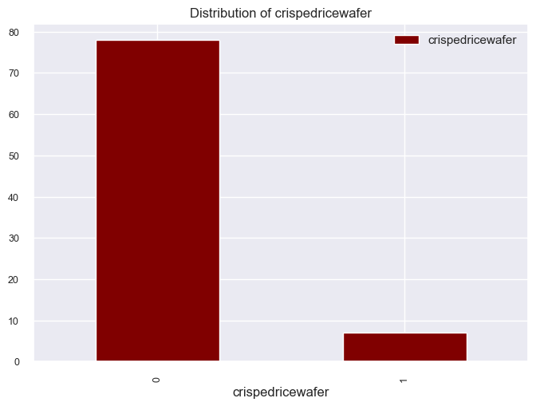
Here we can see that the distribution of crispedricewafer candy is 0-8 .

Slide 7
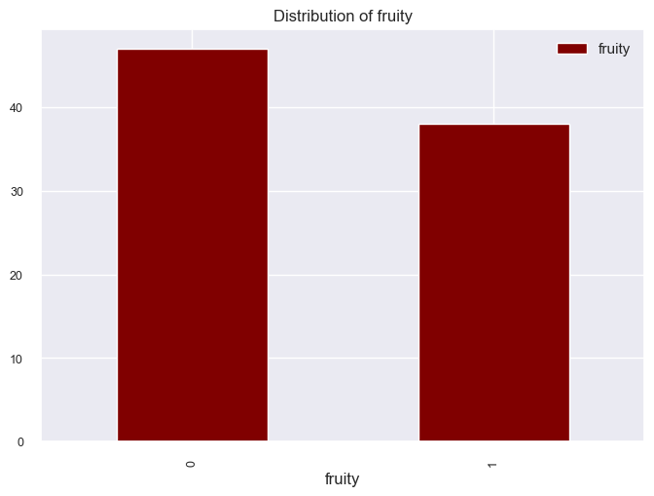
The graph shows the distribution of fruity candy is 35 –38.

Slide 8
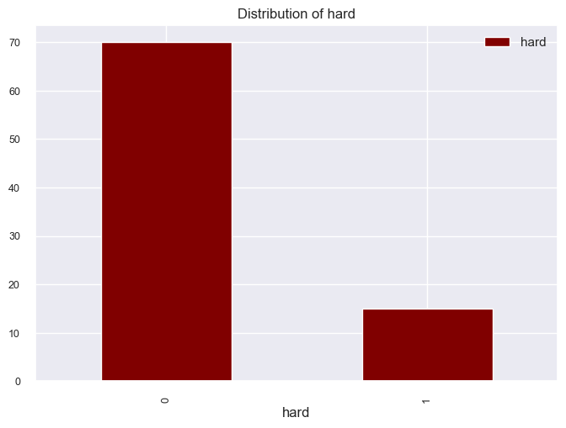
The distribution of hard candy is 10 – 15.

Slide 9
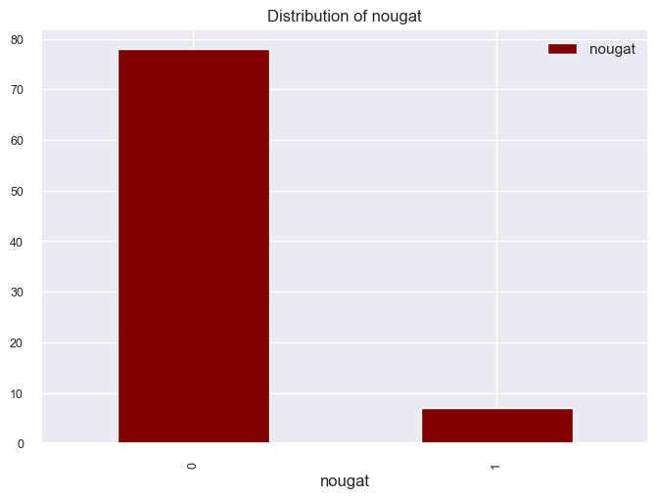
The distribution of nougat candy is 0-8 .
Here we can see that the distribution of nougat is 5-8.

Slide 10
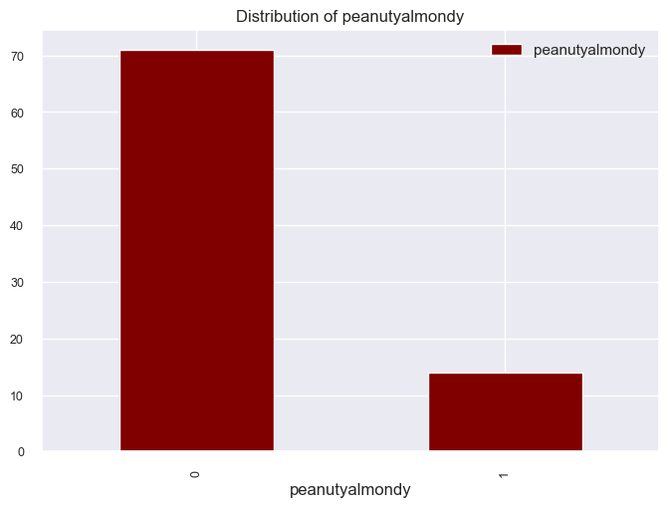
This plot shows the distribution of peanutyalmondy candies is 10 – 14 .
From this graph we can observe that the count of peanutyalmondy candy is 10-15.

Slide 11
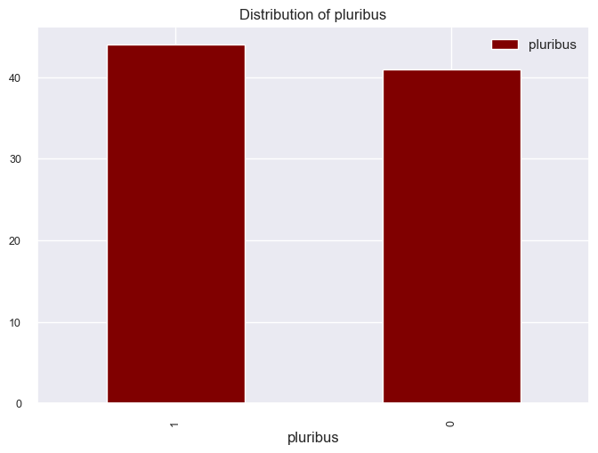
The graph shows that the distribution of pluribus candy is 35 – 41.

Slide 12
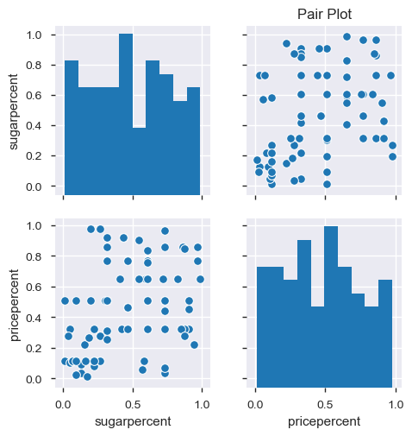
PAIR PLOT
Very weak Relationship between Pricepercent and Sugarpercent.

Slide 13
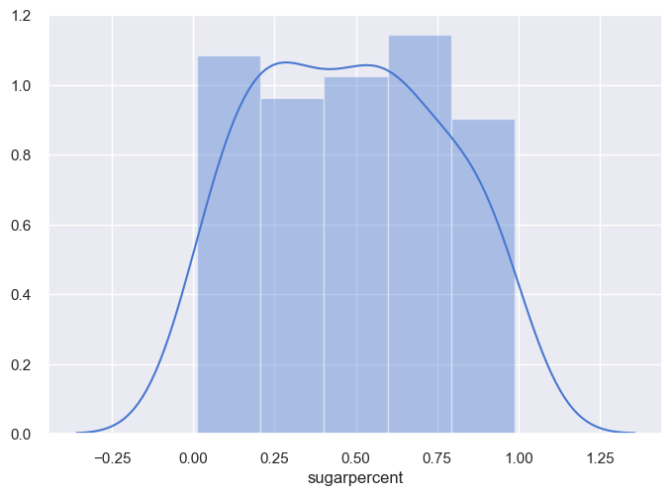
Distribution of Sugar Percent
From this graph we can see that the sugarpercent is uniformly distributed.

Slide 14
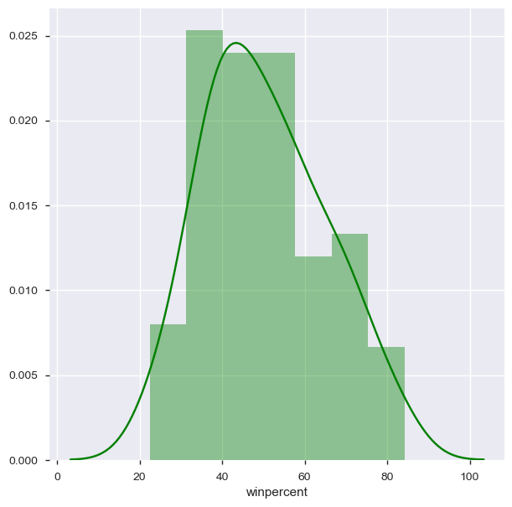
Distribution of Winpercent
Here the winpercent seems to be right skewed.

Slide 15
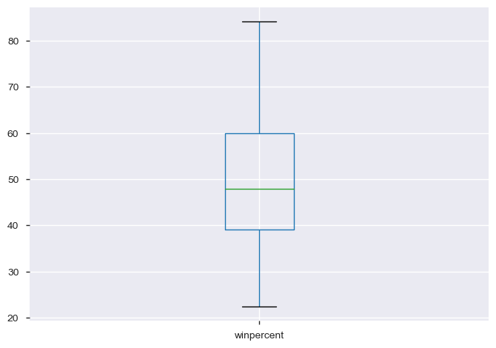
BOX PLOT
The box plot shows us that there are no outliers in the winpercent

Slide 16
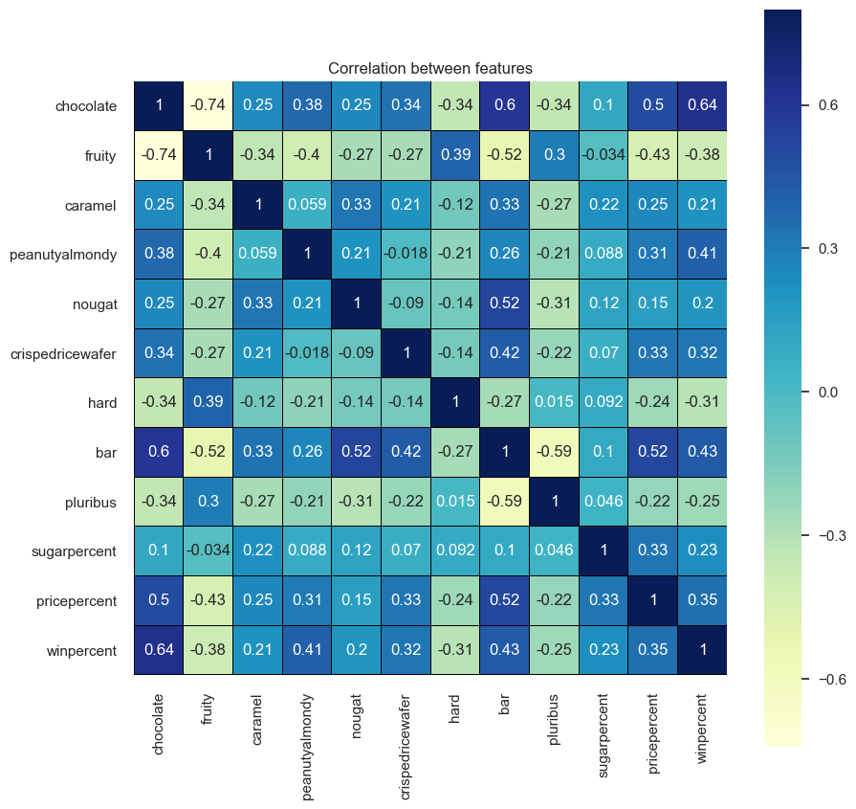
CORRELATION
Here we can see that fruity and chocolate are correlated with each other and same with bar and pluribus.

Slide 17
LINEAR REGRESSION
It is a linear approach to –
modelling a relationship between
a response (or dependent variable)
and one or more explanatory variables(or independent variables)

Slide 18
MODEL STEPS
Below are the steps of the Linear Regression Model-
We have splitted the data into test and train.
We have fitted the model to the training data.
We have predicted the test data .
We have computed the error between the predicted and actual values to find out the model performance.
NOTE: We have used python code to run the model and used scikit learn package from python.

Slide 19
Result
We have calculated Root Mean Square Error (RMSE) to check the model performance and the outcome is 12.924.

Slide 20
THANK YOU

